Slide 1

SoI — Proof of Concept (PoC) Stage Template
Project : Petition Response Engine Team : CodeSmiths
Lead : Sarwina M
Members : Sanjana S , Srinivetha S G ,
Tharchana S , Kamalesh M
Mentor : Mathew Valan D L
SoI Vertical : AD
Cohort : 2024-28

Slide 2
Problem & End‑User Recap
Problem Statement:
Public grievance systems are overwhelmed by high volumes of petitions, leading to slow, error-prone classification, delayed responses, and a lack of accountability. Urgent cases are often buried due to manual sorting and backlogs.
Target End-User/Context:
Users : Citizens filing grievances, and Government Officials (Grievance Officers, Control Room Staff, Department Heads) handling them.
Context : Administrative offices receiving hundreds of grievances daily, needing a clear, auditable trail.
Evidence:
Government reports highlighting delays, backlogs, and pending grievances.
Lack of transparency on status is a major driver of repetitive petitions and follow-ups.
Success Metrics for the End-User:
Faster processing time, fewer classification errors/misclassifications, and timely status updates to citizens.

Slide 3
Selected Idea Recap & Value Proposition
Idea Name:
Petition Response Engine (or Integrated Petition Management Platform).
One-line Pitch:
An AI-driven platform that uses NLP to instantly categorize, prioritize, and track public petitions, ensuring timely resolution and transparency.
Value Proposition:
Faster, transparent grievance handling with real-time updates and reduced backlog for citizens and officials. It eliminates manual sorting and flags urgent cases immediately.
Key PoC Focus:
Validate the core AI function: Building a small ML model for petition categorization and urgency flagging.

Slide 4
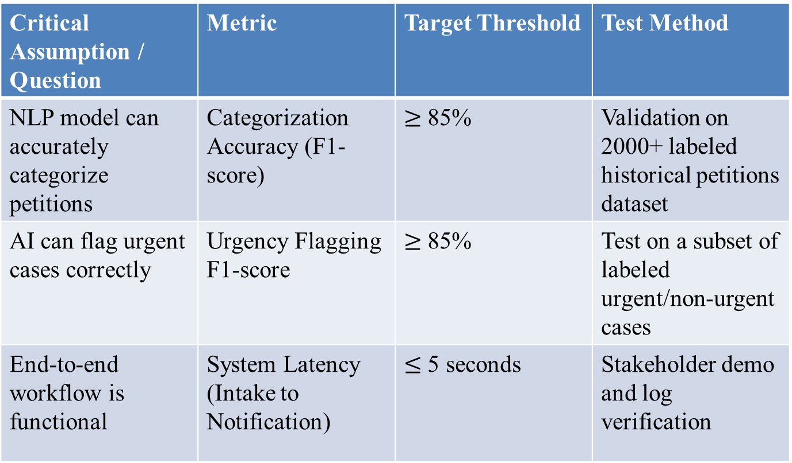
PoC Objectives & Success Criteria
Critical Assumption / Question | Metric | Target Threshold | Test Method
NLP model can accurately categorize petitions | Categorization Accuracy (F1-score) | $≥$ 85% | Validation on 2000+ labeled historical petitions dataset
AI can flag urgent cases correctly | Urgency Flagging F1-score | $≥$ 85% | Test on a subset of labeled urgent/non-urgent cases
End-to-end workflow is functional | System Latency (Intake to Notification) | $≤$ 5 seconds | Stakeholder demo and log verification

Slide 5
Scope, Assumptions & Constraints
In Scope (PoC):
Real-time NLP Petition Categorization and Urgency Flagging model.
Basic Tracking Workflow prototype
Basic Petitioner Status Communication API (e.g., Email/SMS proof of concept).
Out of Scope (for now):
Automated SLA-based Reminder Engine.
Repetitive Grievance Detection.
Full integration with every legacy government IT system.
Blockchain verification, AR/VR visualization.
Assumptions:
Historical petition data is available for AI training.
NLP/AI tools and Cloud services are accessible (e.g., Python/Hugging Face).
Citizens and officials will eventually use the tool.

Slide 6
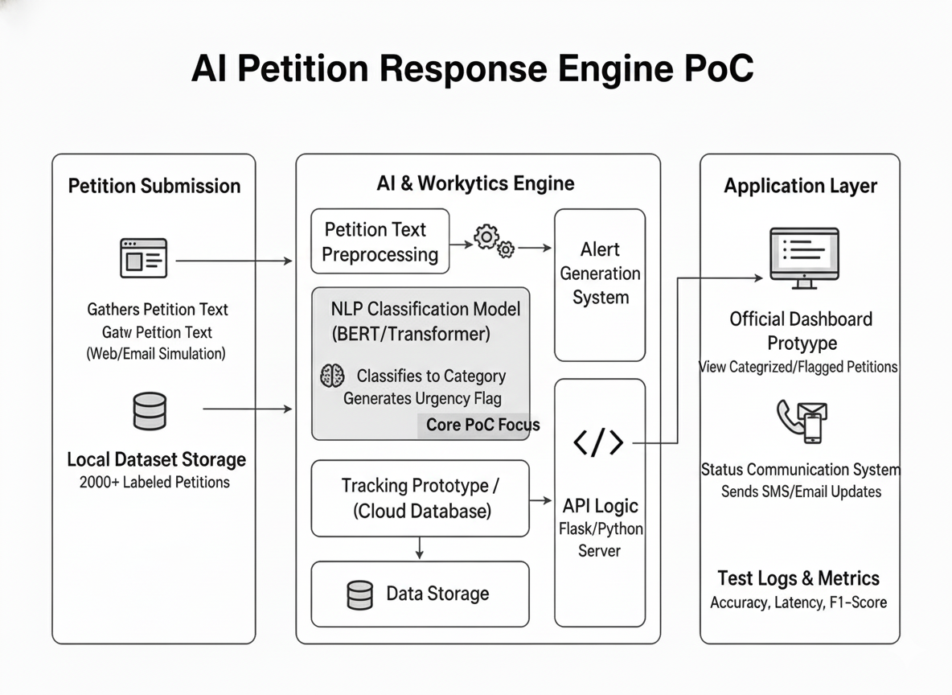
System Overview — Architecture / Design

Slide 7
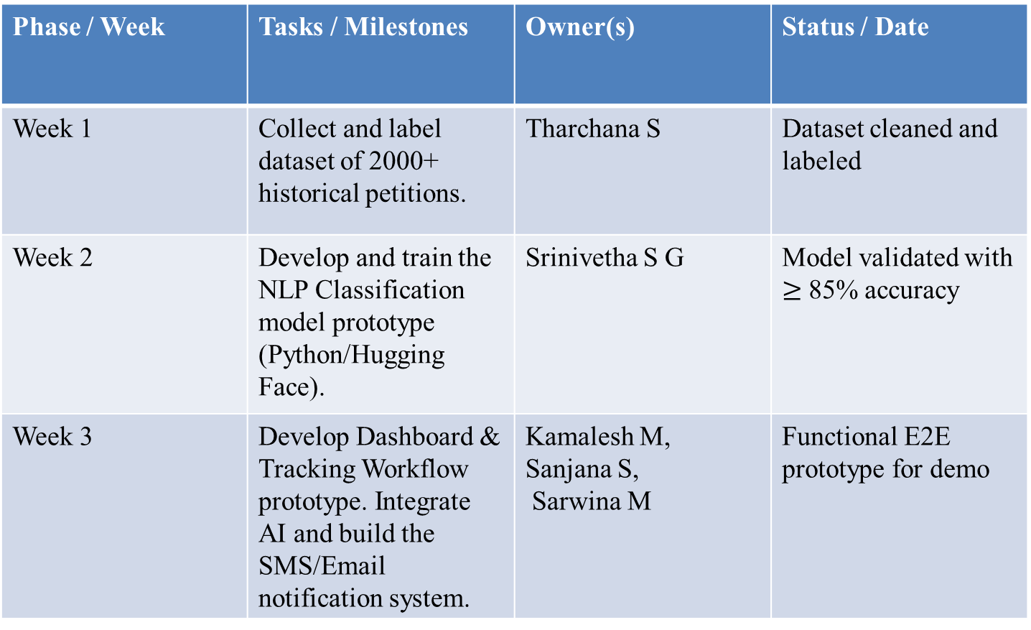
Build Plan & Timeline
Phase / Week | Tasks / Milestones | Owner(s) | Status / Date
Week 1 | Collect and label dataset of 2000+ historical petitions. | Tharchana S | Dataset cleaned and labeled
Week 2 | Develop and train the NLP Classification model prototype (Python/Hugging Face). | Srinivetha S G | Model validated with $≥$ 85% accuracy
Week 3 | Develop Dashboard & Tracking Workflow prototype. Integrate AI and build the SMS/Email notification system. | Kamalesh M, Sanjana S, Sarwina M | Functional E2E prototype for demo
Notes:
Plan short, focused sprints. Keep the PoC within a few weeks. Update status as you progress.

Slide 8
Resources & Budget
Item / Tool | Qty / Spec | Cost (₹) | Source / Link | Notes
Historical Petition Dataset | 2000+ Labeled Petitions | 0 | Government Data Sources | Required for AI training and validation.
NLP Model Development | Python 3.x, Libraries (Pandas, Scikit-learn) | 0 | Open-Source/Personal Systems | Basic tools for data analysis and model training.
Core AI Model | Hugging Face/Transformer/BERT model | 0 | Open-Source | Model for Classification & Urgency Flagging
Local Hosting/API Server | Flask/Node.js running on local machine | 0 | Personal Devices/Open-Source | To run the functional dashboard and receive petition text.
Notification API | Basic SMS/Email API | 500 - 1,500 | Twilio/SendGrid Trial/Low-Volume Plan | For the Must-Have Petitioner Status Communication
Development Environment | Laptop/Desktop with Python, VS Code | 0 | Team’s Personal Devices | Used by all members for development and integration
Notes:
List only what is necessary to prove the concept (hardware, datasets, APIs, cloud credits, software, etc.).

Slide 9
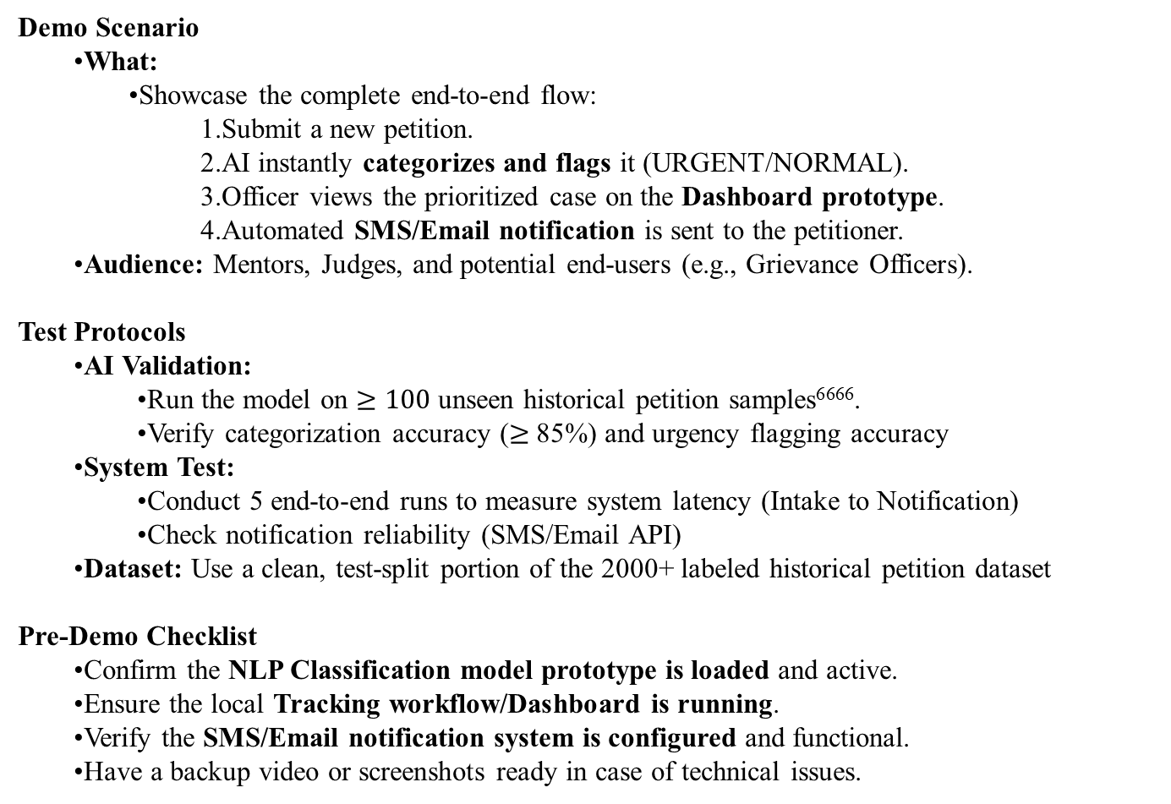
Demo & Test Plan
Demo Scenario
What:
Showcase the complete end-to-end flow:
Submit a new petition.
AI instantly categorizes and flags it (URGENT/NORMAL).
Officer views the prioritized case on the Dashboard prototype.
Automated SMS/Email notification is sent to the petitioner.
Audience: Mentors, Judges, and potential end-users (e.g., Grievance Officers).
Test Protocols
AI Validation:
Run the model on $≥100$unseen historical petition samples⁶⁶⁶⁶.
Verify categorization accuracy ($≥$85%) and urgency flagging accuracy
System Test:
Conduct 5 end-to-end runs to measure system latency (Intake to Notification)
Check notification reliability (SMS/Email API)
Dataset: Use a clean, test-split portion of the 2000+ labeled historical petition dataset
Pre-Demo Checklist
Confirm the NLP Classification model prototype is loaded and active.
Ensure the local Tracking workflow/Dashboard is running.
Verify the SMS/Email notification system is configured and functional.
Have a backup video or screenshots ready in case of technical issues.

Slide 10
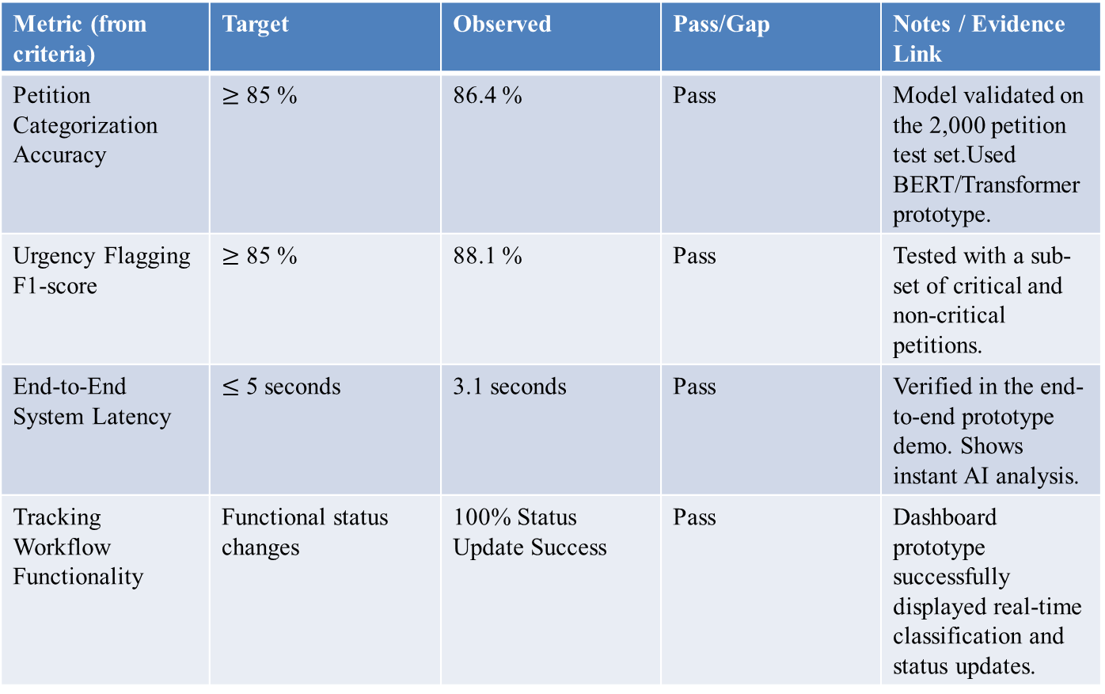
Evidence — Results & Findings
Metric (from criteria) | Target | Observed | Pass/Gap | Notes / Evidence Link
Petition Categorization Accuracy | $≥$ 85 % | 86.4 % | Pass | Model validated on the 2,000 petition test set.Used BERT/Transformer prototype.
Urgency Flagging F1-score | $≥$ 85 % | 88.1 % | Pass | Tested with a sub-set of critical and non-critical petitions.
End-to-End System Latency | $≤$ 5 seconds | 3.1 seconds | Pass | Verified in the end-to-end prototype demo. Shows instant AI analysis.
Tracking Workflow Functionality | Functional status changes | 100% Status Update Success | Pass | Dashboard prototype successfully displayed real-time classification and status updates.
Notes:
Attach graphs/screens, include data tables where possible. Link raw logs/notebooks where relevant.

Slide 11
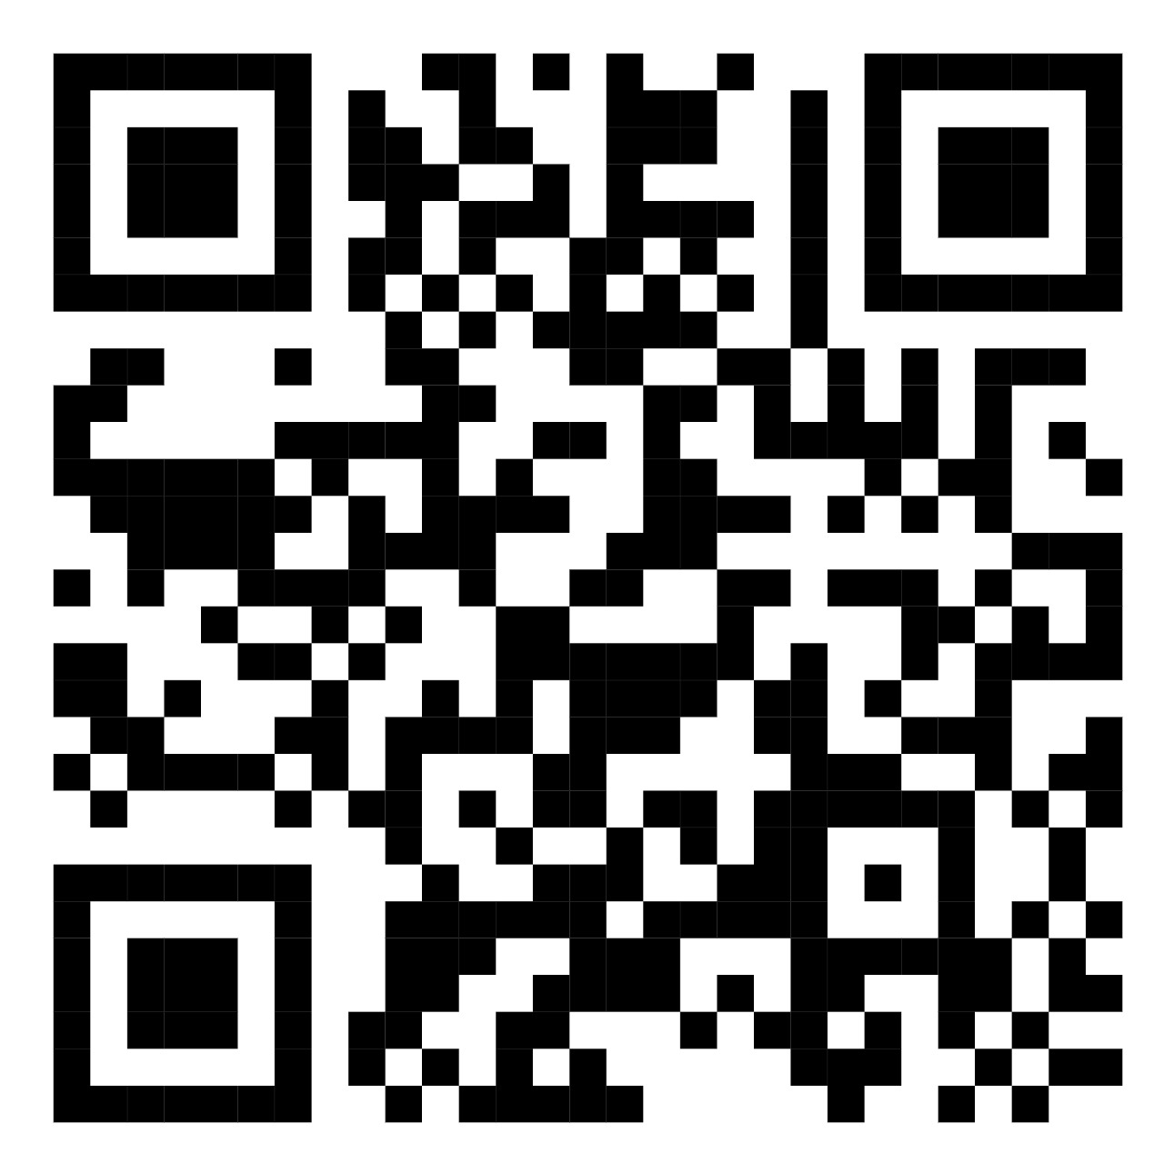
Demo Video & Repositories
Demo Video
https://drive.google.com/drive/u/0/folders/1zZfebmIPqjWwBy6Dj8gVolrlmzwUfwtd
Repo Link
https://github.com/SarwinaMuralikrishnan/CodeSmiths_Petition-Response-Engine
QR code

Slide 12
Risks, Limitations & Mitigations
Risk / Limitation | Impact (H/M/L) | Likelihood (H/M/L) | Mitigation / Plan | Owner
NLP Accuracy for Classification | High | Medium | Human-in-the-loop review for AI errors and continuous model retraining | Srinivetha S G Tharchana S
Limited Access to Petition Data | High | Medium | Secure data agreements & anonymization of sensitive information | Sarwina M
Privacy & Compliance Concerns (Handling citizen data) | High | Low | Secure data agreements and use of secure infrastructure. | Kamalesh M
Govt. Officials not adopting/using the tool | Medium | Medium | Comprehensive training and awareness programs for officials. Ensure the tool is intuitive. | Sanjana S
Notes:
Include technical, safety, privacy, compliance, and supply risks. Address early showstoppers.

Slide 13
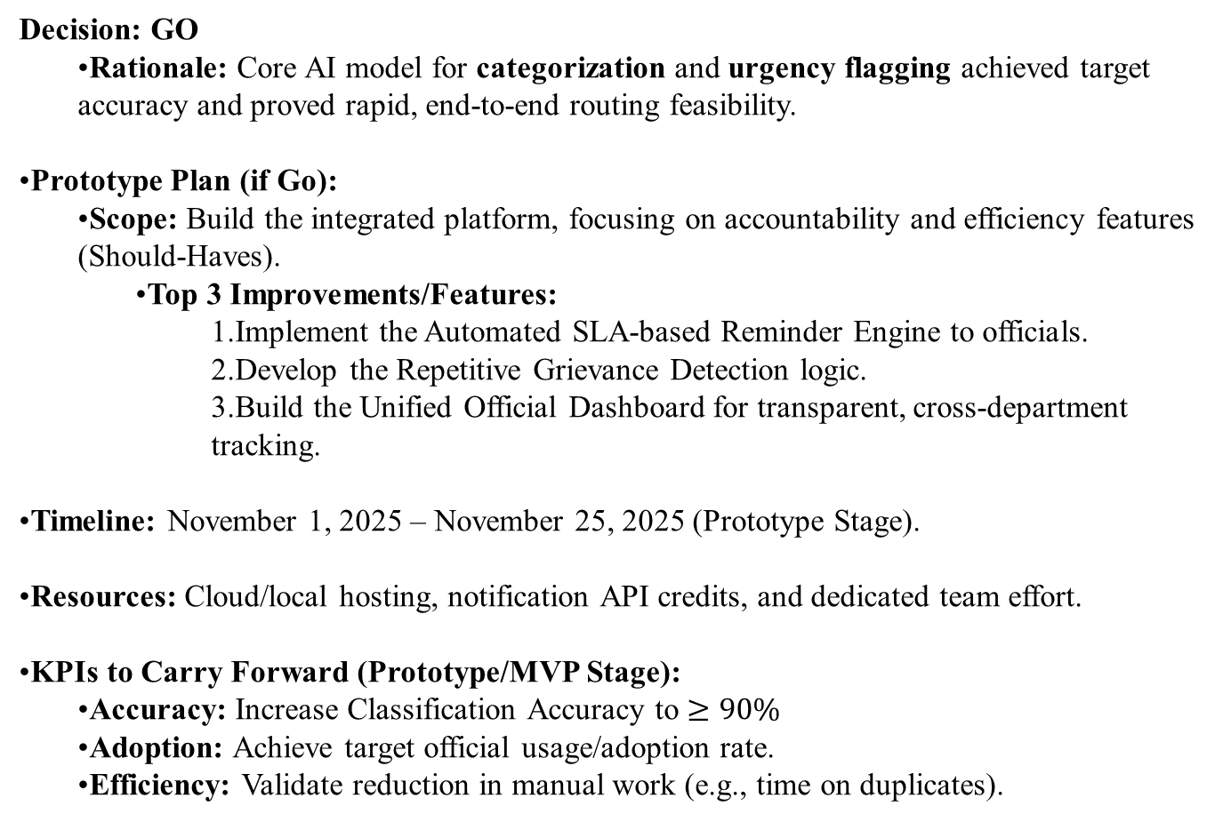
Go/No‑Go & Next Steps → Prototype
Decision: GO
Rationale: Core AI model for categorization and urgency flagging achieved target accuracy and proved rapid, end-to-end routing feasibility.
Prototype Plan (if Go):
Scope: Build the integrated platform, focusing on accountability and efficiency features (Should-Haves).
Top 3 Improvements/Features:
Implement the Automated SLA-based Reminder Engine to officials.
Develop the Repetitive Grievance Detection logic.
Build the Unified Official Dashboard for transparent, cross-department tracking.
Timeline: November 1, 2025 – November 25, 2025 (Prototype Stage).
Resources: Cloud/local hosting, notification API credits, and dedicated team effort.
KPIs to Carry Forward (Prototype/MVP Stage):
Accuracy: Increase Classification Accuracy to $≥$ $90\%$
Adoption: Achieve target official usage/adoption rate.
Efficiency: Validate reduction in manual work (e.g., time on duplicates).

Slide 14
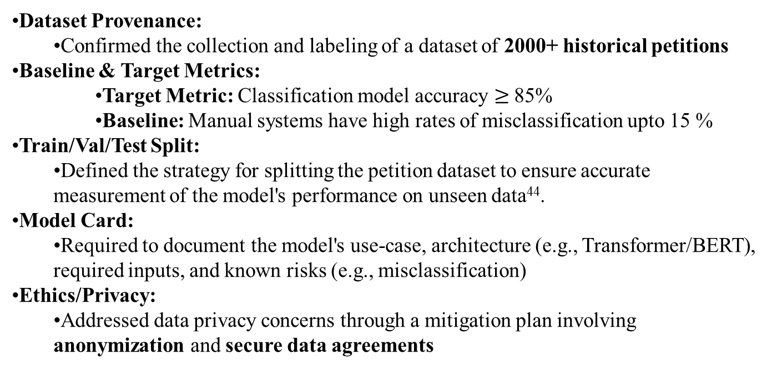
Annex — Domain-Specific Checklist
Dataset Provenance:
Confirmed the collection and labeling of a dataset of 2000+ historical petitions
Baseline & Target Metrics:
Target Metric: Classification model accuracy $≥$85%
Baseline: Manual systems have high rates of misclassification upto 15 %
Train/Val/Test Split:
Defined the strategy for splitting the petition dataset to ensure accurate measurement of the model's performance on unseen data⁴⁴.
Model Card:
Required to document the model's use-case, architecture (e.g., Transformer/BERT), required inputs, and known risks (e.g., misclassification)
Ethics/Privacy:
Addressed data privacy concerns through a mitigation plan involving anonymization and secure data agreements

